Slide 1

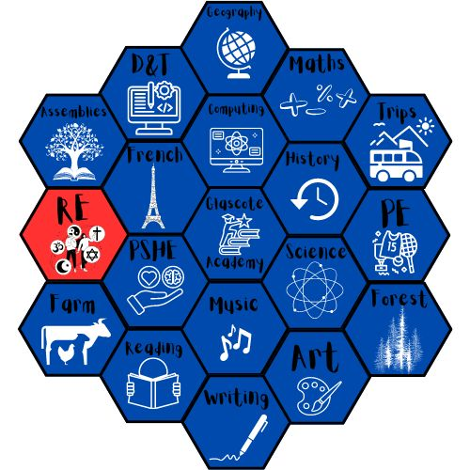

Religious Education
Curriculum

Slide 2
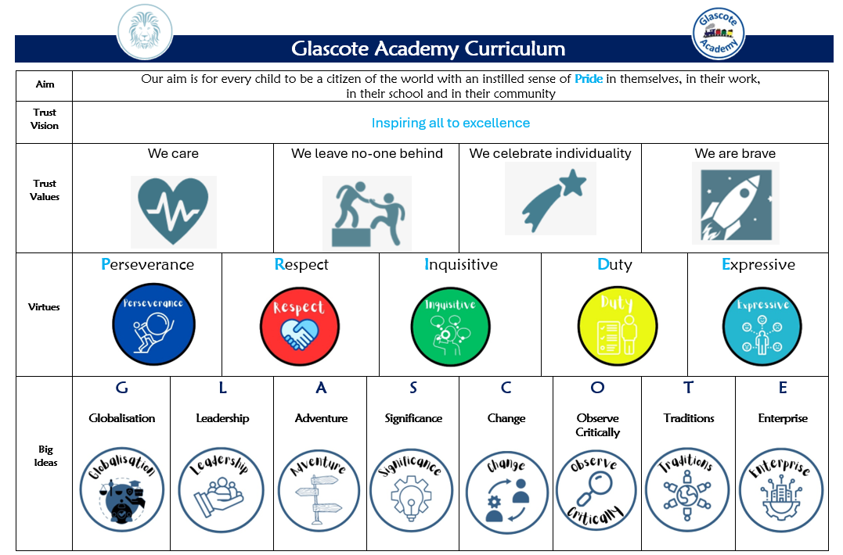
The Curriculum – Our approach

Slide 3


Curriculum Intent
Raises aspirations and open’s their eyes to a world beyond their immediate surroundings
Upholds and promotes our vision of “Pride”
Shapes independent and co-operative learners who learn from their mistakes
Promotes a life-long love of learning
We consider our Glascote Family to be special and unique and as such our pupils deserve a curriculum that…
Promotes practical everyday life skills that prepare them for their future
Promotes creativity, curiosity, and confidence
Secures knowledge and skills across all EYFS and National Curriculum subjects that build upon prior knowledge
Builds character, resilience, self-motivation, and a will to succeed

Slide 4
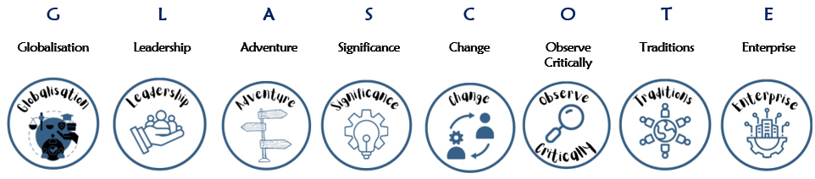

Subject Specific Sequencing and Key Concepts: Each subject has been planned to ensure that knowledge and skills are sequenced from Early Years to Year 6. Key Concepts are the subject specific ‘Golden Threads’ that children will learn about, return to and revisit as they progress through our school. Our pupils will have opportunities to link new learning to prior knowledge thus building a rich and deep knowledge of these ‘Golden Threads’ with each encounter. (See RE long term plan with key concepts)
Big Ideas:
These are the overarching ‘Glascote’ concepts that pupils can use and apply across different curriculum subjects. For example, in all areas of the curriculum, children will build an understanding of ‘significance’; learning about significant authors, artists, scientific discoveries, pieces of music, figures and events from different cultures, religions and history.
Character Virtues:
These are the underpinning qualities and character traits stemming from ‘Pride’ that we desire all of our children, and staff, to demonstrate.

Slide 5





IMPLEMENTATION – Our approach
Religious Education at Glascote Academy, is taught by following the scheme of work from Jigsaw. We chose Jigsaw for our pupils as we believe that it supports our aim to build citizens of the world, our intrinsic values, virtues and ‘Big Ideas’. Furthermore, it fulfills the requirements of the Staffordshire Agreed Syllabus.
"Jigsaw's Religious Education scheme of work aims to provide an innovative and comprehensive scheme of work for Religious Education (for ages 3-12) as RE is a vitally important component of children’s personal, social and spiritual development. Developing an understanding of their own and others’ worldviews underpins the growth of empathy and respect. Appreciating that we all see the world through the lens that has been formed by our experiences, upbringing, culture etc and that this influences our decision-making and our own way of seeing the world is so valuable." (Jigsaw Primary)

Slide 6
IMPLEMENTATION – Our approach
As a school we use Jigsaw RE, a comprehensive scheme of work, to ensure that we remain compliant with the recent updates that have been made to Staffordshire’s Locally Agreed Syllabus for RE.
The children will develop their understanding of RE and will be given opportunities to explore, discuss and challenge a range of values, attitudes, beliefs, rights and responsibilities. Through this, children will develop a range of skills and strategies that will aid them in becoming tolerant, informed and responsible citizens.
Visitors and people from the community offer additional learning opportunities which complement our RE curriculum. For example, at the end of every term, the whole school visit the neighbouring Sacred Heart Church in which we receive a blessing and talk about the religious significance of the season (if applicable).
Staff at Glascote Academy create a positive attitude towards religious education learning and promote the expectation that all children can achieve highly through adaptive teaching. Recall, repetition, modelling and practice are key facilitators used to support all children in their learning. Key vocabulary is an integral part of each unit of work, enabling children to have a greater understanding of important key concepts, ‘Golden Threads’, thus enabling them to communicate Religious information with confidence.

Slide 7
EYFS Development Matters 2020: Understanding of the World
Understanding the world involves guiding children to make sense of their physical world and their community. The frequency and range of children’s personal experiences increases their knowledge and sense of the world around them – from visiting parks, libraries and museums to meeting important members of society such as police officers, nurses and firefighters. In addition, listening to a broad selection of stories, non-fiction, rhymes and poems will foster their understanding of our culturally, socially, technologically and ecologically diverse world. Children in Reception will be learning to: Talk about members of their immediate family and community Understand that some places are special to members of their community Recognise that people have different beliefs and celebrate special times in different ways
Key stage 1: Pupils should develop knowledge about a range of Worldviews, including but not limited to Christianity, Islam and Judaism. They will explore and reflect on religious stories, learn about significant people/ events and ask questions about their relationship with God. They will find out about how important events in the religious calendar are celebrated in each Worldview. Key stage 2: Pupils should expand their knowledge of Worldviews, exploring the origins of religious literature and assessing the similarities and differences between them. They will explore interpretations from stories in religious scripture and reflect on the impact it has on modern life. Pupils should explore the significance of previously learnt festivals and how these events bring people closer to God.

Slide 8
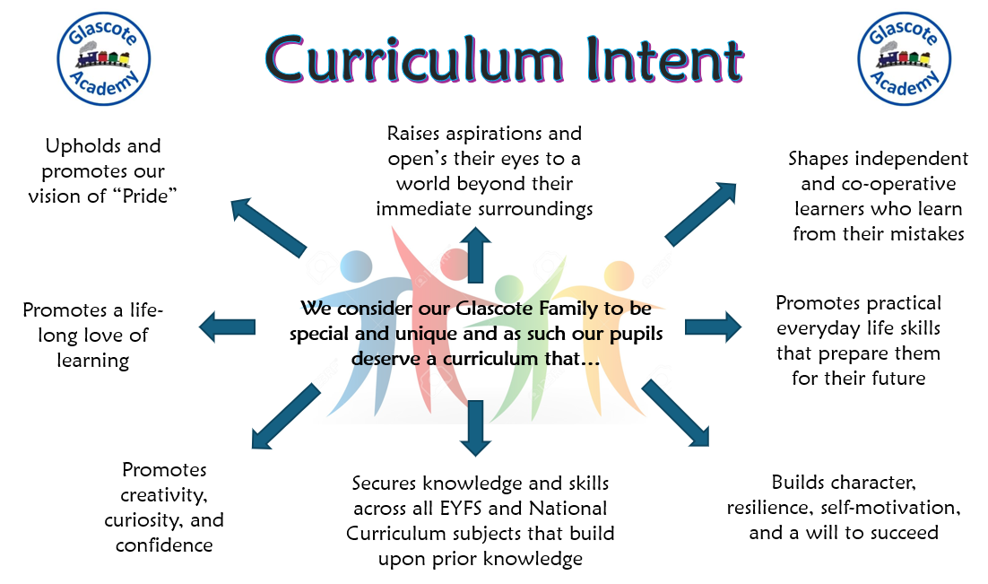
IMPACT– Our approach
At Glascote Academy, we are determined that teaching and learning in all subjects is driven by our curriculum intent. Therefore, we monitor the impact of learning in each lesson through teacher observations, discussions, low-stake quizzes and work produced which is evidenced in children’s books, displays, and Curriculum Power Points.
Impact is also measured at the end of a unit of work through:
the use of subject specific Assessment One Notes
Internal and external picture building

